Slide 1

Deep Learning - 1
Machine Learning for Chemistry and Drug Design
Maitreya Maity
IHUB-DATA, IIIT Hyderabad

Slide 2


Plans for today
Perceptron
Multilayer Perceptron
Backpropagation Algorithm
Hyperparameter Tuning

Slide 3
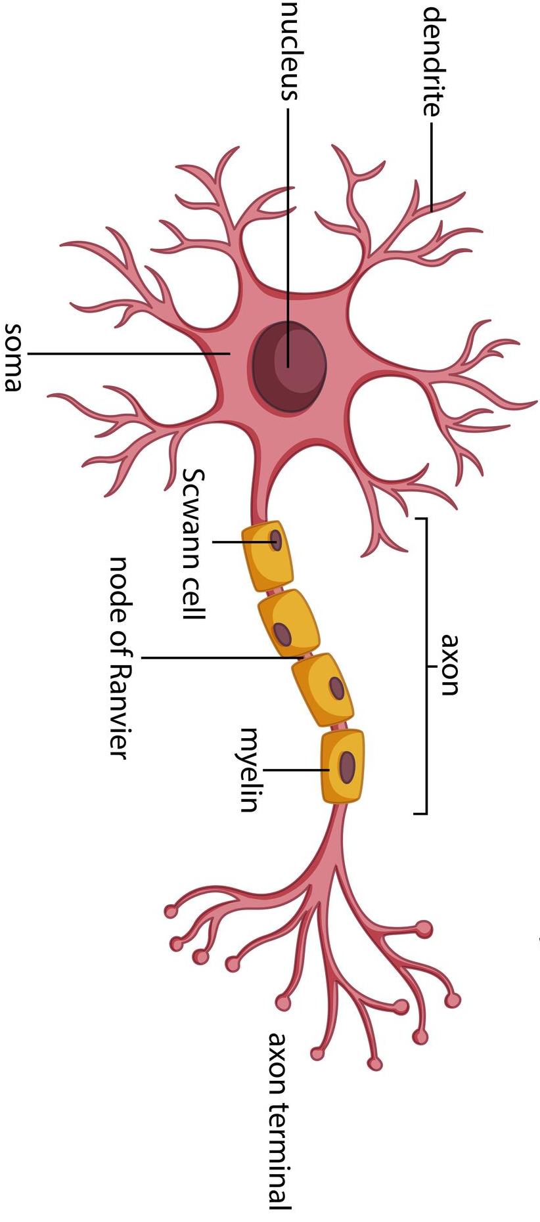
Biological inspiration of Artificial Neural Network
Neuron is the basic building block of the nervous system
Dendrites receive information from other neurons
Soma is the processing unit
Axon sends the processed information
In 1957, an American scientist named Franck Rosenblatt developed the concept of perceptron at Cornell Aeronautical Laboratory
A neuron receives data from other neurons
Neuron integrates all the impulses
Neuron will be activated if the resulting summation is larger than a certain threshold values
* Image courtesy: https://www.vecteezy.com/vector-art/358962-diagram-of-neuron-anatomy

Slide 4
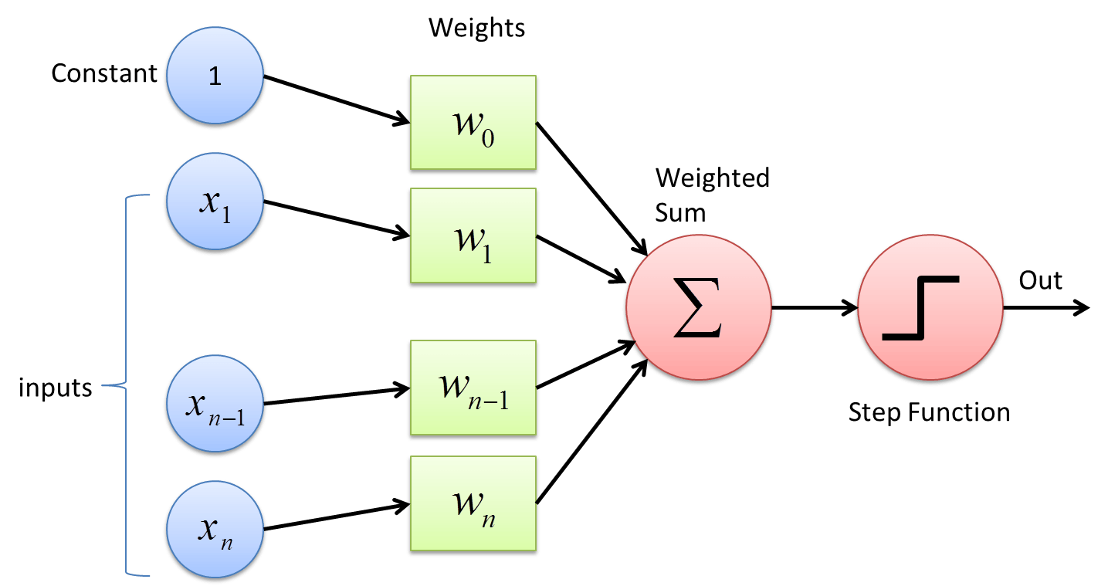
Perceptron
Perceptron is a building block of an Artificial Neural Network
A binary classifier with three primary parts
Input layer – It takes the input data (real value) for processing
Weight and bias – Weight or connection weight parameter represent the strength of the connection. Bias (intercept) is a constant factor
Activation function – Determines whether a neuron will fire (Activate) or not
* Image courtesy: https://deepai.org/machine-learning-glossary-and-terms/perceptron

Slide 5
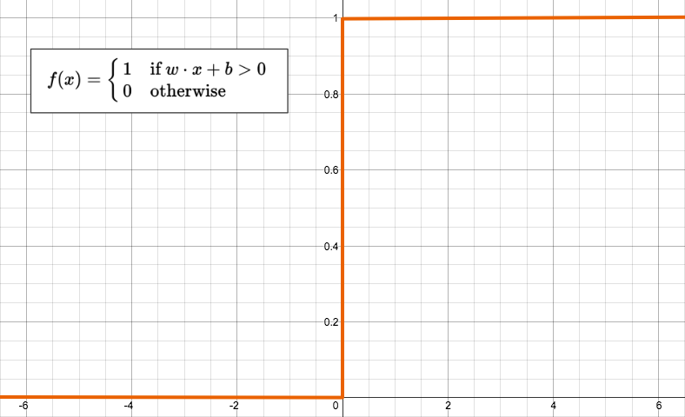

Perceptron
Sum of inputs
$$y=\sum_{j=1}^{d}{w_{j}x_{j}+w_{0}}$$
where,$x_{j}∈ℜ$, j=1,…,d, $w_{j}∈ℜ$
$$y=w^{T}x$$
where, $w={\left[w_{0},w_{1},…,w_{d}\right]}^{T}$, $x=\left[1,x_{1},…,x_{d}\right]$
Activation function – Step function
$$z=g\left(y\right)=\left\{\begin{aligned}1 \\ 0\end{aligned}\right.\begin{matrix}y>0 \\ otherwise\end{matrix}$$
* Image courtesy: https://appliedgo.net/perceptron/

Slide 6
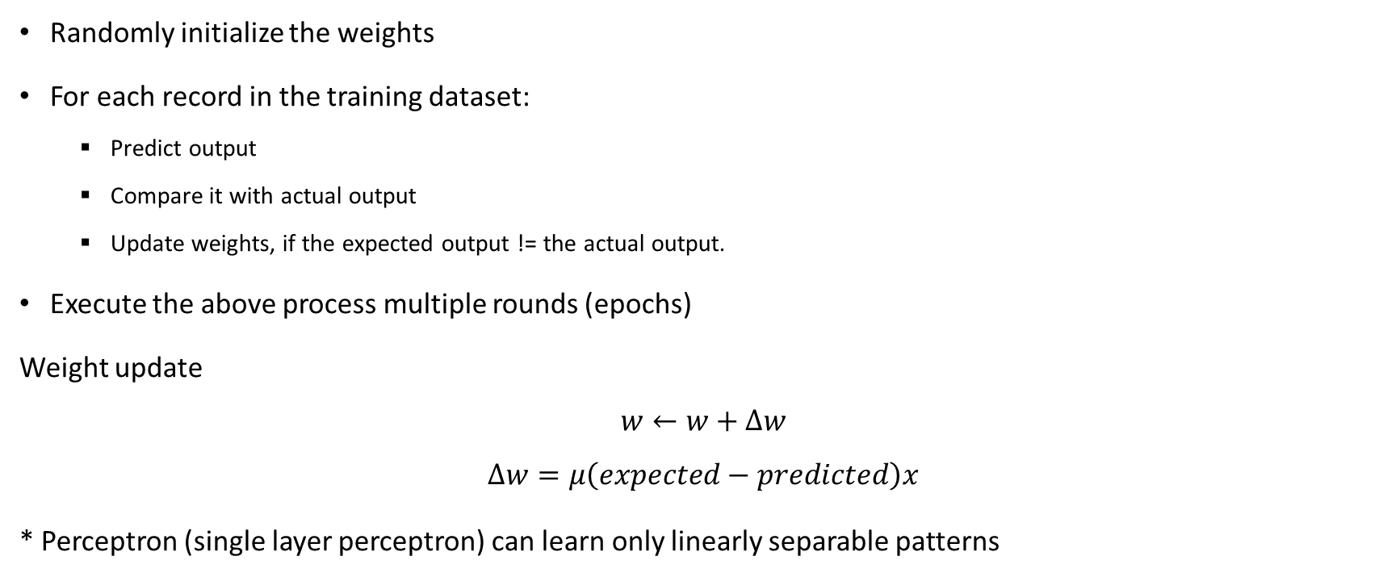
How Perceptron Learn
Randomly initialize the weights
For each record in the training dataset:
Predict output
Compare it with actual output
Update weights, if the expected output != the actual output.
Execute the above process multiple rounds (epochs)
Weight update
$$w←w+∆w$$
$$∆w=μ\left(expected−predicted\right)x$$
* Perceptron (single layer perceptron) can learn only linearly separable patterns

Slide 7
Code Implementation

Slide 8
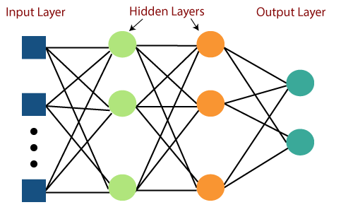
Multilayer Perceptron
A multilayer perceptron (MLP) consists of interconnected neurons transferring information to each other
Input layer - Initial layer of the network which takes in an input
Hidden layer (s) - Perform computations and operations on the input data (input-output relationships)
Output layer - Demonstrate a meaningful output
Feedforward neural network – Data is transmitted from the input layer to the output layer in forward direction
* Image courtesy: https://www.javatpoint.com/multi-layer-perceptron-in-tensorflow

Slide 9
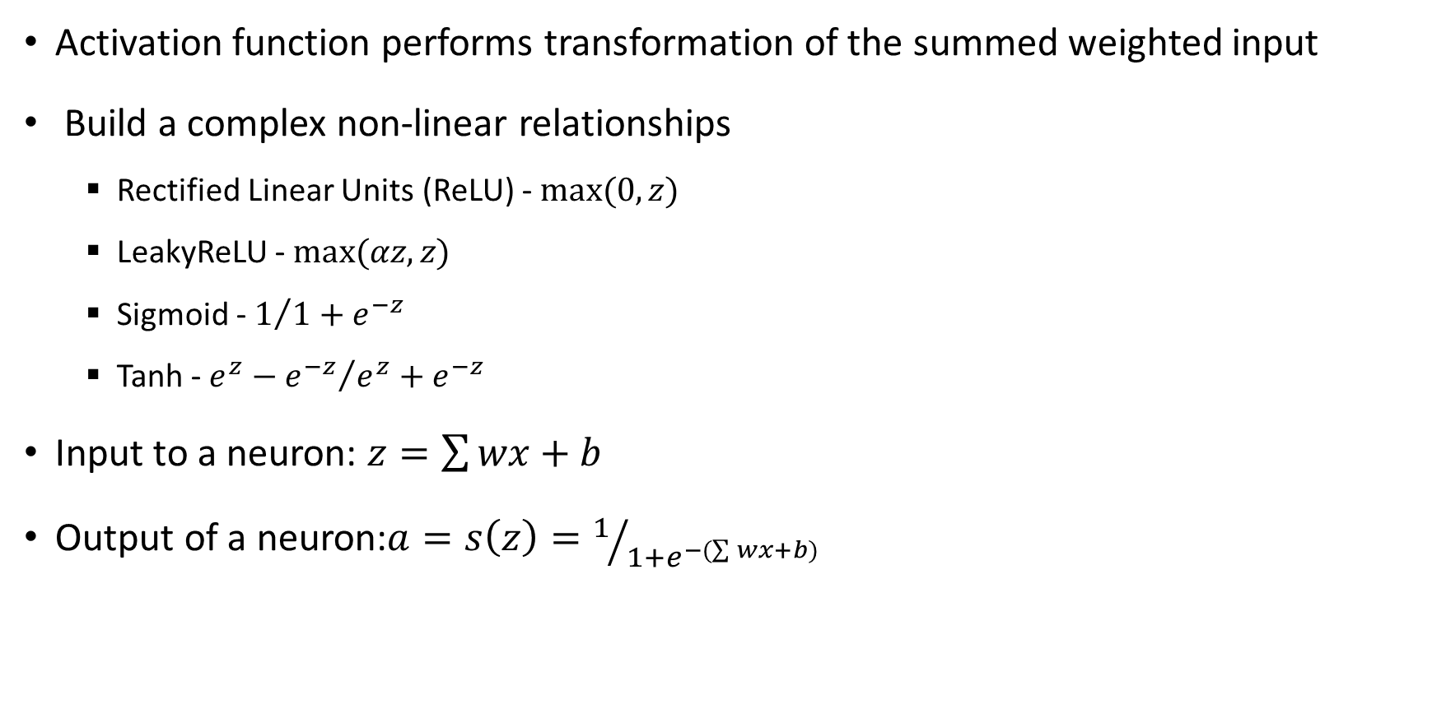
Activation Functions - MLP
Activation function performs transformation of the summed weighted input
Build a complex non-linear relationships
Rectified Linear Units (ReLU) - $max⁡(0,z)$
LeakyReLU - $max⁡(αz,z)$
Sigmoid - $1/{1+e^{−z}}$
Tanh - ${e^{z}−e^{−z}}/{e^{z}+e^{−z}}$
Input to a neuron: $z=\sum{wx}+b$
Output of a neuron:$a=s\left(z\right)=1/{1+e^{−(\sum{wx}+b) }}$

Slide 10
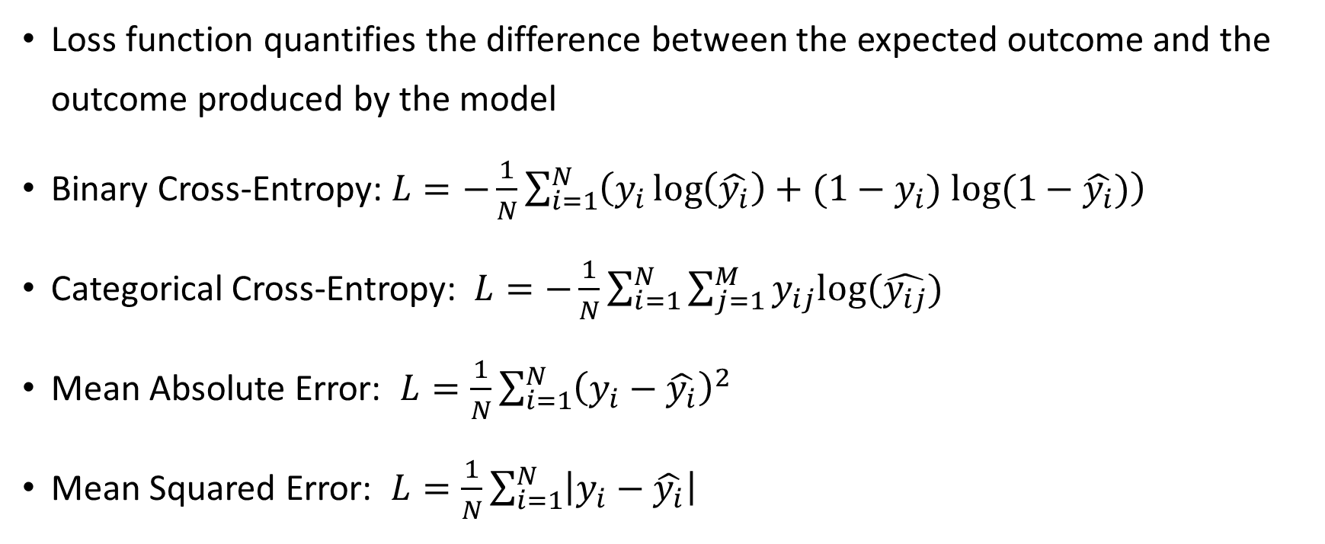
Loss Functions - MLP
Loss function quantifies the difference between the expected outcome and the outcome produced by the model
Binary Cross-Entropy: $L=−\frac{1}{N}\sum_{i=1}^{N}{\left(y_{i}\log\left(\hat{y_{i}}\right)+(1−y_{i}) log⁡(1−\hat{y_{i}})\right)}$
Categorical Cross-Entropy: $L=−\frac{1}{N}\sum_{i=1}^{N}{\sum_{j=1}^{M}{y_{ij}log⁡(\hat{y_{ij}})}}$
Mean Absolute Error: $L=\frac{1}{N}\sum_{i=1}^{N}{{\left(y_{i}−\hat{y_{i}}\right)}^{2}}$
Mean Squared Error: $L=\frac{1}{N}\sum_{i=1}^{N}{\left|y_{i}−\hat{y_{i}}\right|}$

Slide 11
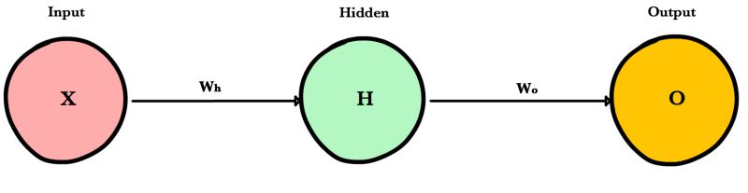
Principle of MLP
MLP works in two stages -
Forward propagation
Information flows forward to compute predictions and the error
The input data is forwarded layer by layer across the network to the final layer, which generates a prediction
Prediction = g(g(XW_{h})W_{o})
g() = activation function, X= input, W_{h} , W_{o} = weights
Backward propagation
Backpropagation algorithm computes the error derivatives and updates the network weights
* Image courtesy: https://ml-cheatsheet.readthedocs.io/en/latest/forwardpropagation.html

Slide 12
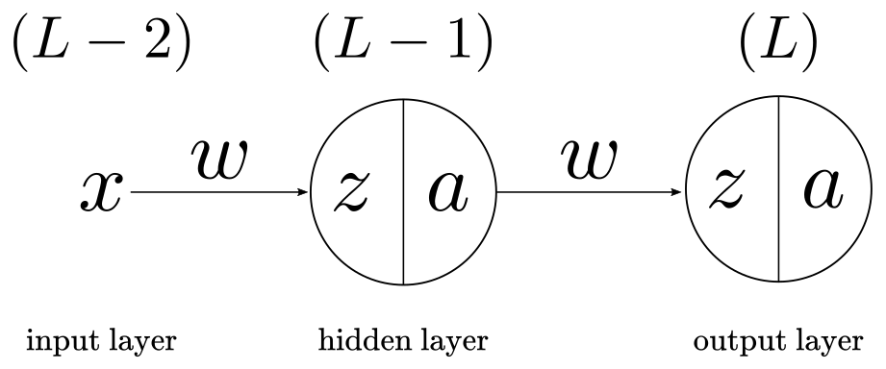
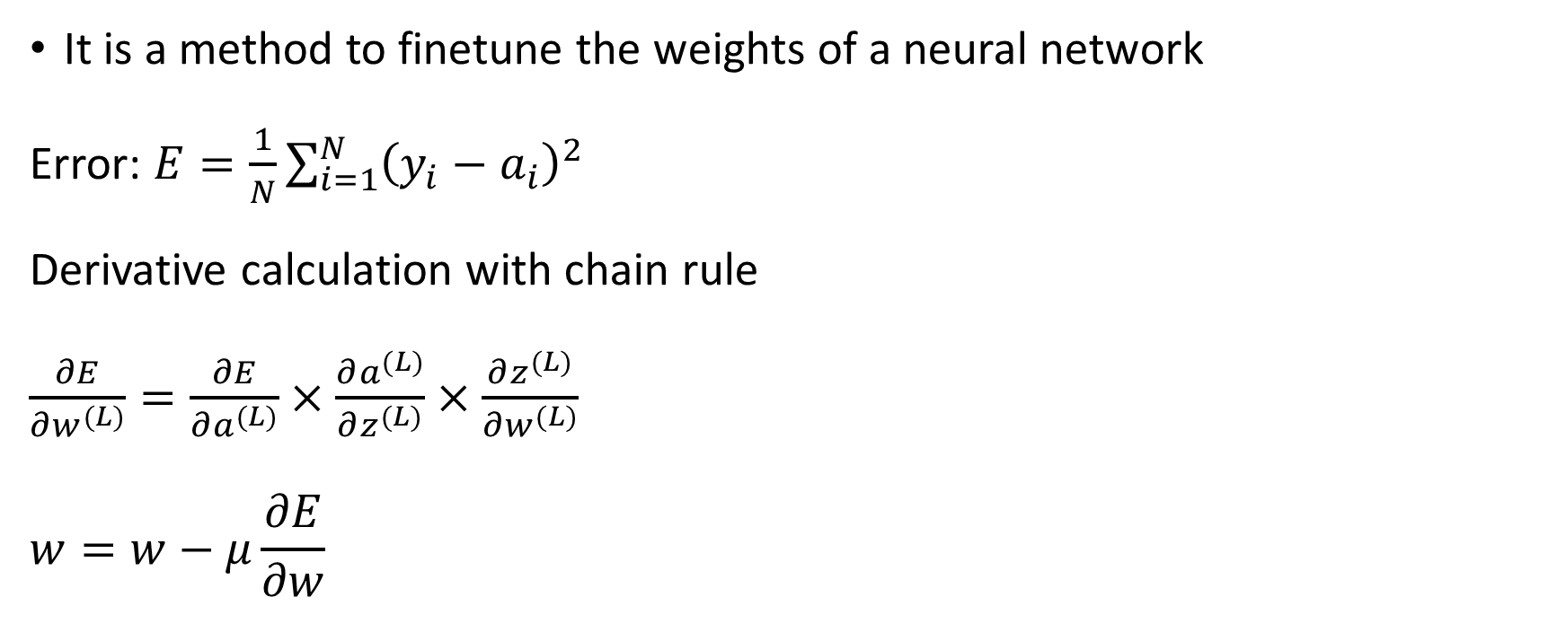
Backpropagation
It is a method to finetune the weights of a neural network
Error: $E=\frac{1}{N}\sum_{i=1}^{N}{{\left(y_{i}−a_{i}\right)}^{2}}$
Derivative calculation with chain rule
$\frac{∂E}{∂w^{(L)}}=\frac{∂E}{∂a^{(L)}}×\frac{∂a^{(L)}}{∂z^{(L)}}×\frac{∂z^{(L)}}{∂w^{(L)}}$
$$w=w−μ\frac{∂E}{∂w}$$
* Image courtesy: https://pabloinsente.github.io/the-multilayer-perceptron

Slide 13
Hyperparameter Tuning
Grid Search
An exhaustive searching technique to find the best parameter subset
A set of parameters is manually provided and all possible combinations of parameters values are evaluated by the learning model
Random Search
Replaces the exhaustive searching technique by selecting parameters randomly from a specific distribution

Slide 14
Code Implementation

Slide 15
Thank you

